Slide 1
INRODUCTION

Slide 2

The reasons that made us
build this system
01
02
03
04
05
We do not usually visit hospitals unless we need to but this visit does not always gives us good experience. We face various problems there.
many people in Egypt have many difficulties to get the right medicine
to have the appropriate doctor and standards while searching for
The old system of hospitals are not very user friendly. The first big stem is waiting in the queue for long hours.
to learn at your own level how to take care of our selves and our families

Slide 3

✓ Producing a mobile application
Strong Authentication
and Authorization
Project objectives
is well formed and easy to use
Producing strong and well content

Slide 4
Baselines for Project scope
Deploying
The scope of project is determined by the team leader and the team members for overall the project in which we define the parts of project each part is assigned to team member which be in his responsibility
Testing
Implementation
Project phases
System Design
System analysis
Preliminary investigations

Slide 5
Design Innovation Process
preliminary investigations
system analysis
system design
In this phase we collect data with data gathering techniques to determine the overall data to be used in the process of development in the project
We also define the user of the application
Getting the project specification and need for the development process
Making an analysis of a current system to be done
Delivering the scenario for each user dealing with the application Sample
Develop use case diagrams according to the scenario
Defining the operation made by each user
This is an important phase in which we define the system working design
We develop DFD “ data flow diagram” descriping the process of developing the application .Sample Text
Developing ERD “entity relationship diagrm”

Slide 6
Design Innovation Process
implementation
testing
deploying
In this phase we will use programming language which will be
Android java sdk for mobile application
Php-html5-css3 for web application
We will use the firebase server for generating our database
Using testing techniques ( unit , whit box , black box)
We test both mobiles
Compatibility , usability and performance measurements
Will be applied for testing criteria
The last phase will be deployed which will be creating apk files for mobile application and the web pages for the website and make it available for use in any device

Slide 7




Tools and technologies
Android Studio
Firebase
Java

Slide 8
Why Android
Popular mobile device OS: 52% of U.S.
Developed by Open Handset Alliance, led by Google
Google claims 900,000 Android device

Slide 9
Why Java
It’s almost entirely object-oriented
It’s more platform independent
It’s more secure

Slide 10

Why Firebase

Slide 11
System Analysis

Slide 12
Context DFD Diagram
Ask
Doctor
System
Patient Info
Doctor Info
Patient
Doctor
Question
Question
Answer
Answer
Doctor Info
Requests for Covid or News
Requests for Covid or News
Covid 19 or news
Covid 19 or news

Slide 13
Doctor
Requests of news or covid info
Show
News,
Covid
News or Covid 19 info
Write
Answers
Record
Answers
Write
Question
Record
Questions Record
Questions
Answers
Record
Patients Record
Patients file
Doctors Info
Questions File
Requests of news or covid info
News or Covid 19 info
Questions ,
Answers
Create
Patients
Record
Questions
Send&receive
Questions
And
Answers
Patients Record
Create
Doctors
Record
Patients Info
Answer
Patient
Doctor Record
Gitting
Doctors
Info
Doctors Info
Doctors Record
Doctors Record
Doctors file

Slide 14
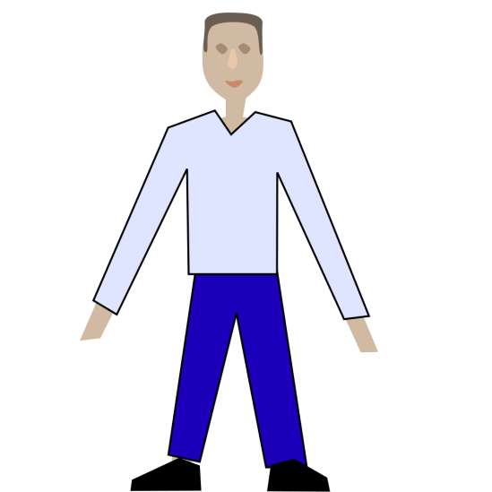
Use Case Diagram
login
Register
Ask
Answer
Patient
Doctor
Show
Health News
Show
Covid Info

Slide 15
Functional Requirements
Register & Login
Doctor info
Database
Profile
The System must allow the user to register & Login
The System must show doctor communications info for patient
System Database must contain all related info About users
System must allow to user to find his profile

Slide 16
Non-Functional Requirements
Appearance
Availability
Response
throughput
Simple look and good feel to use
The System must be available all time of the Year
The System must be response to user in less than 1 second
The System Shall be able to serve Up to 10k Users per day

Slide 17
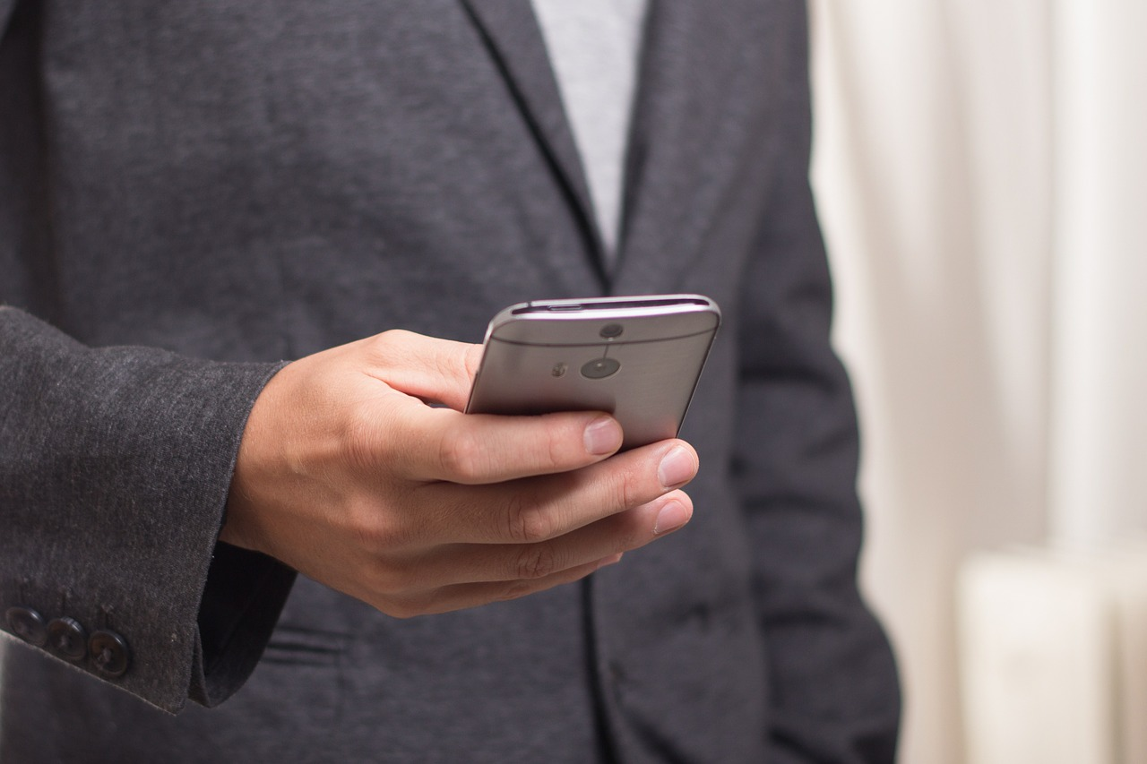
Implementation

Slide 18
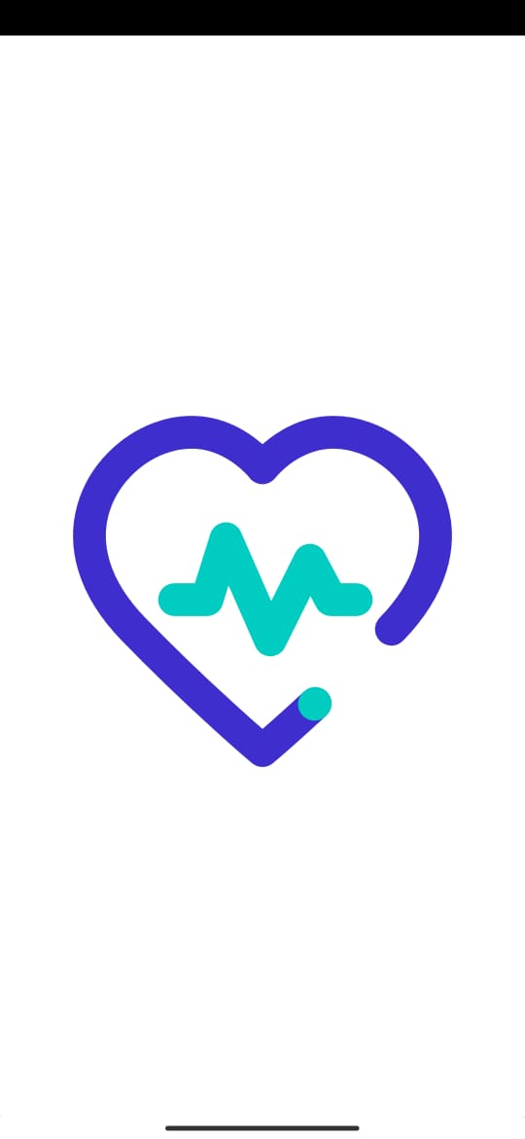
Splash Screen

Slide 19
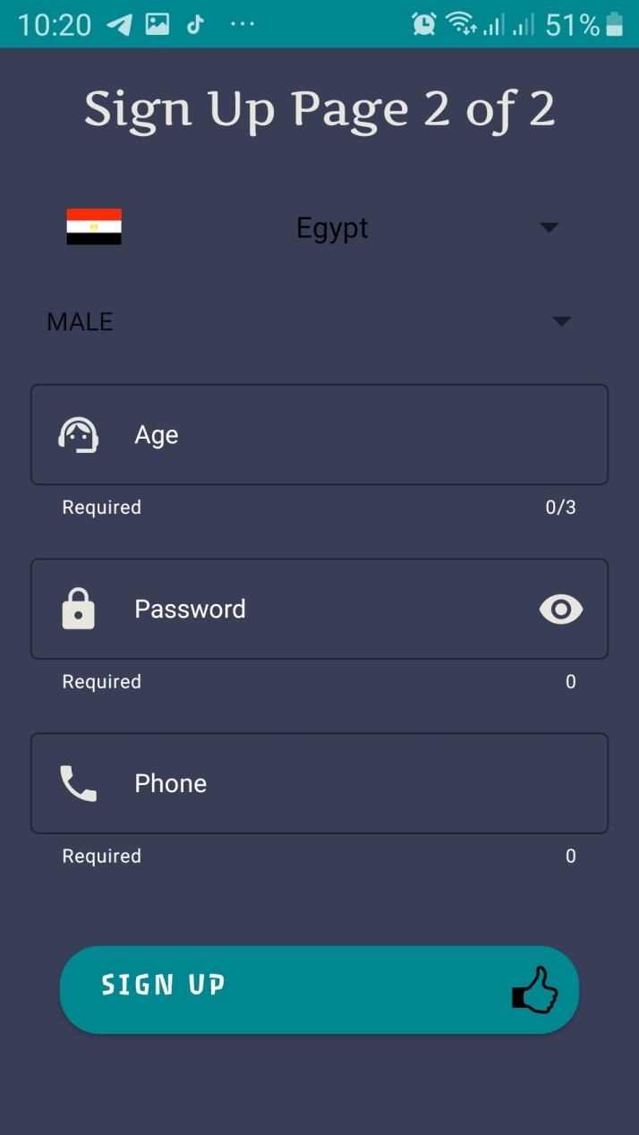
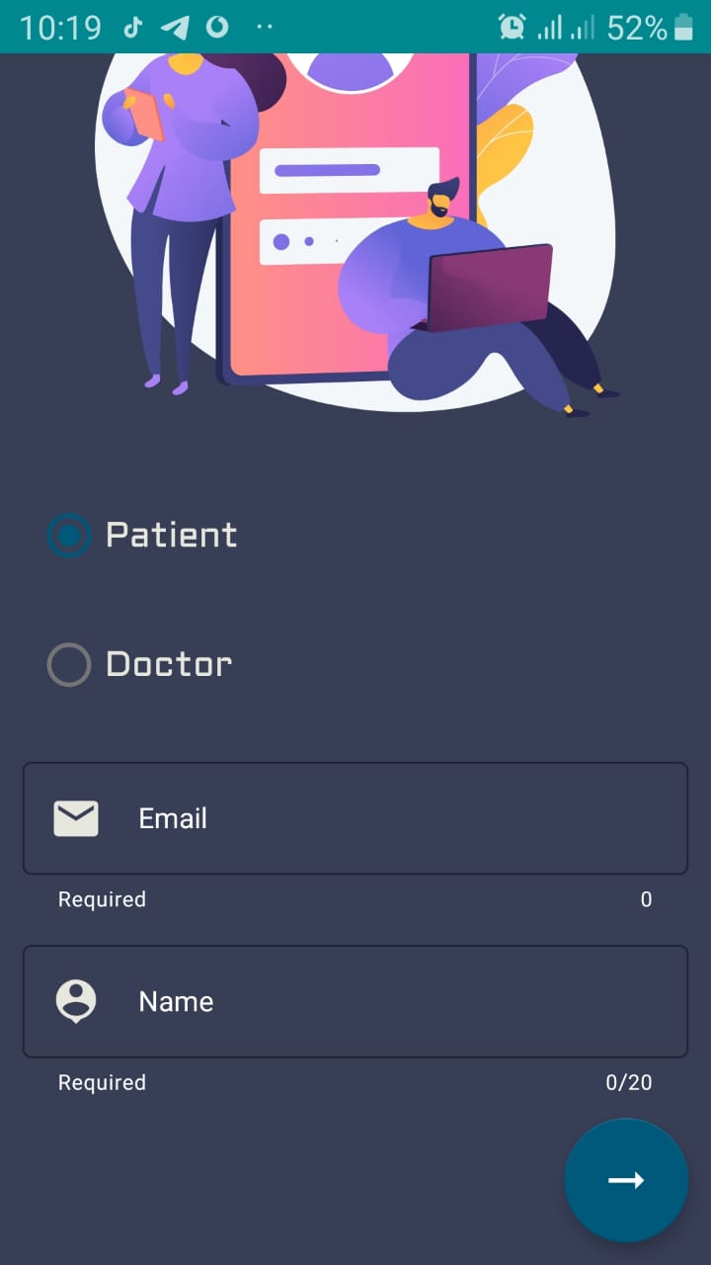
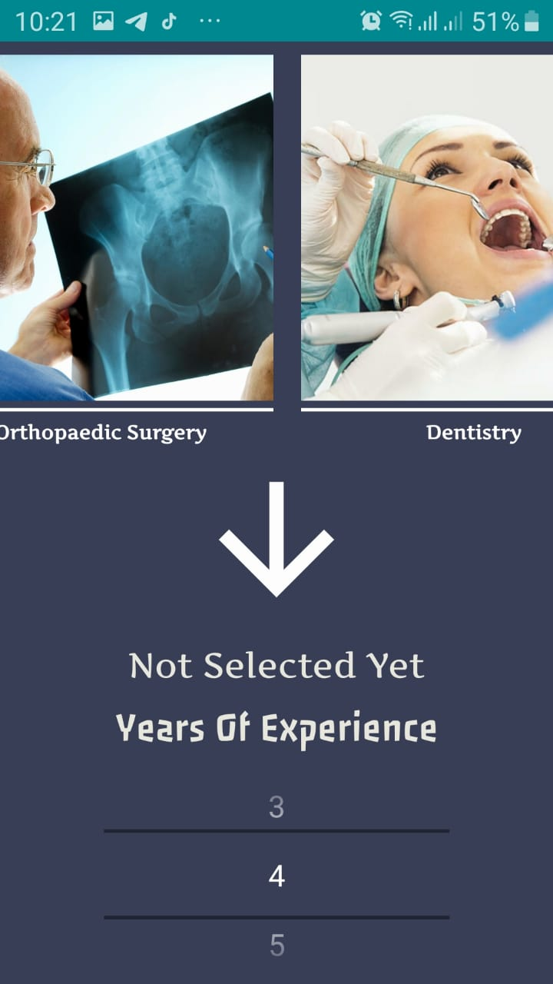
Sign up

Slide 20
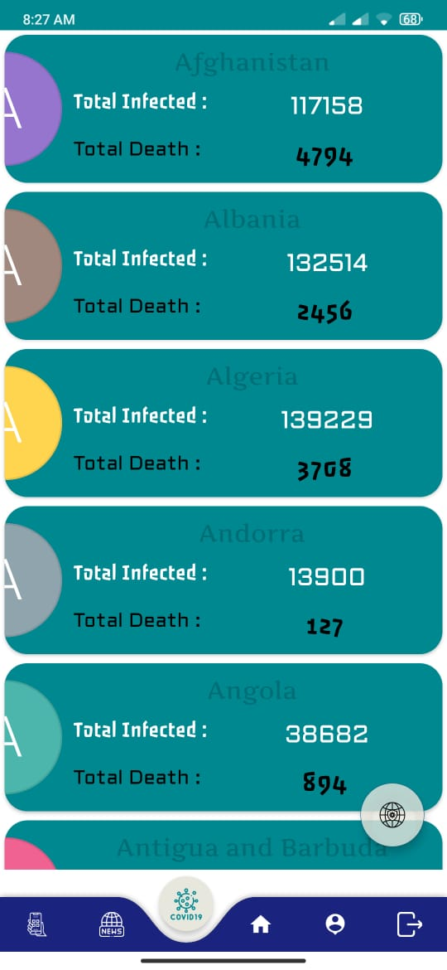
Covid 19 Status

Slide 21
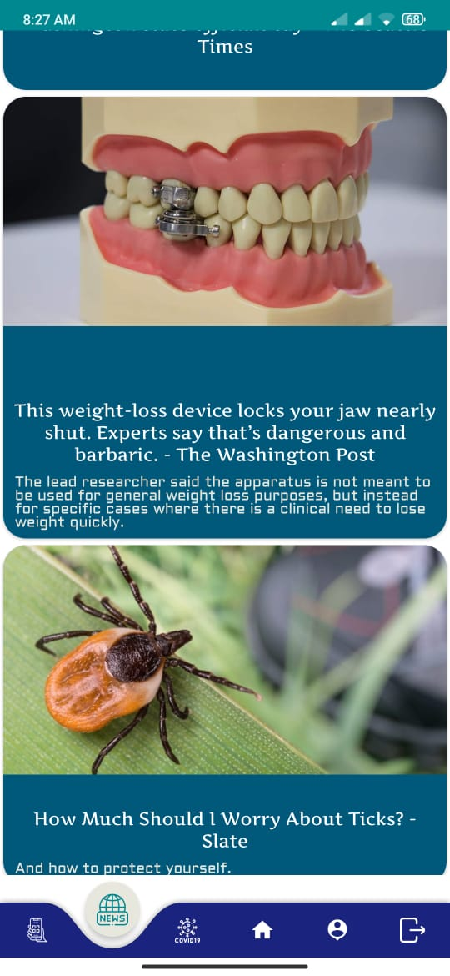
News Fragment

Slide 22
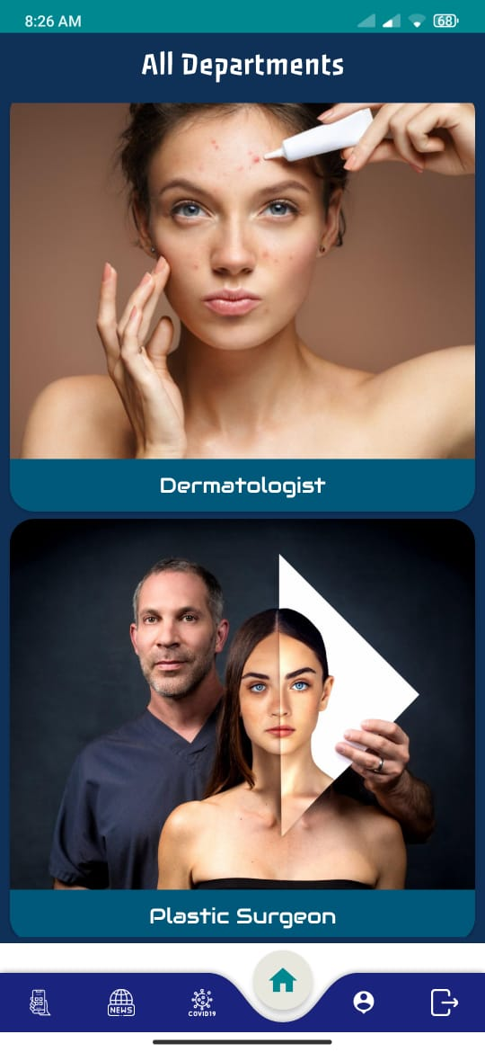
Home Fragment

Slide 23
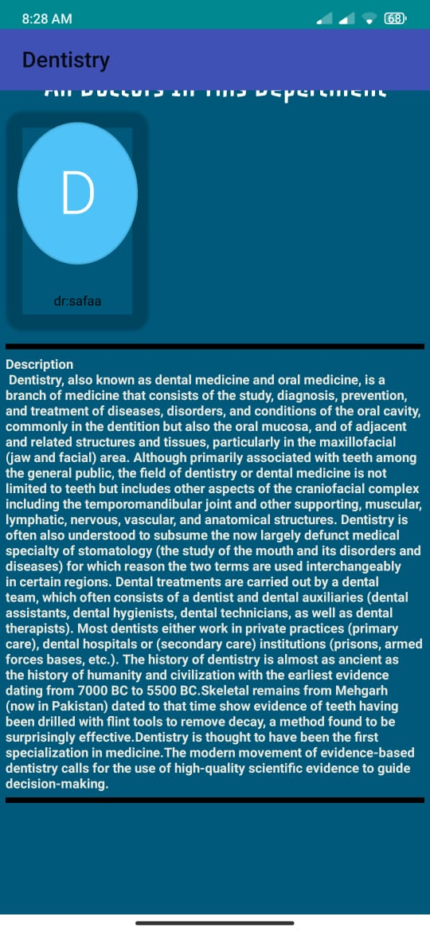
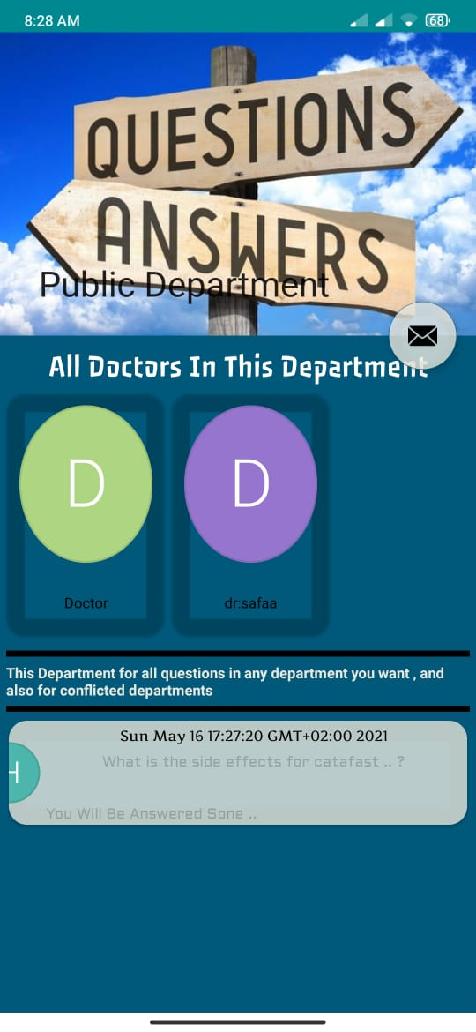
Departments

Slide 24
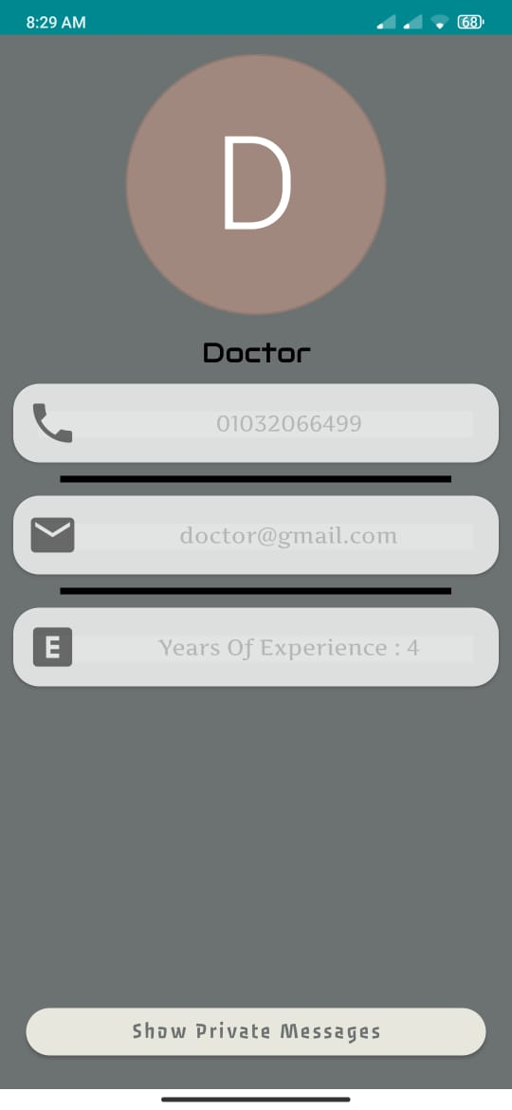
About Fragment

Slide 25
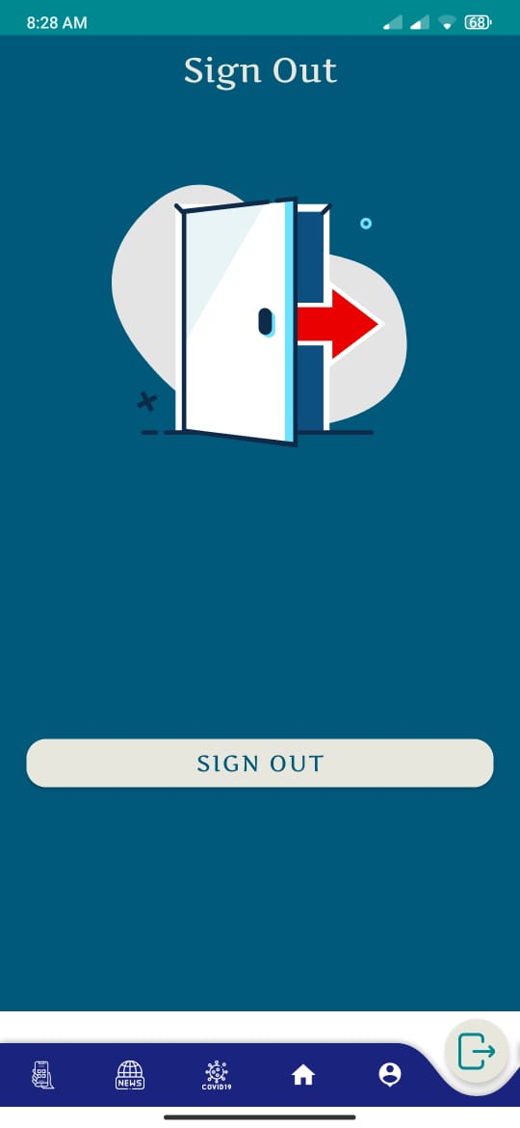
Sign out

